Slide 1
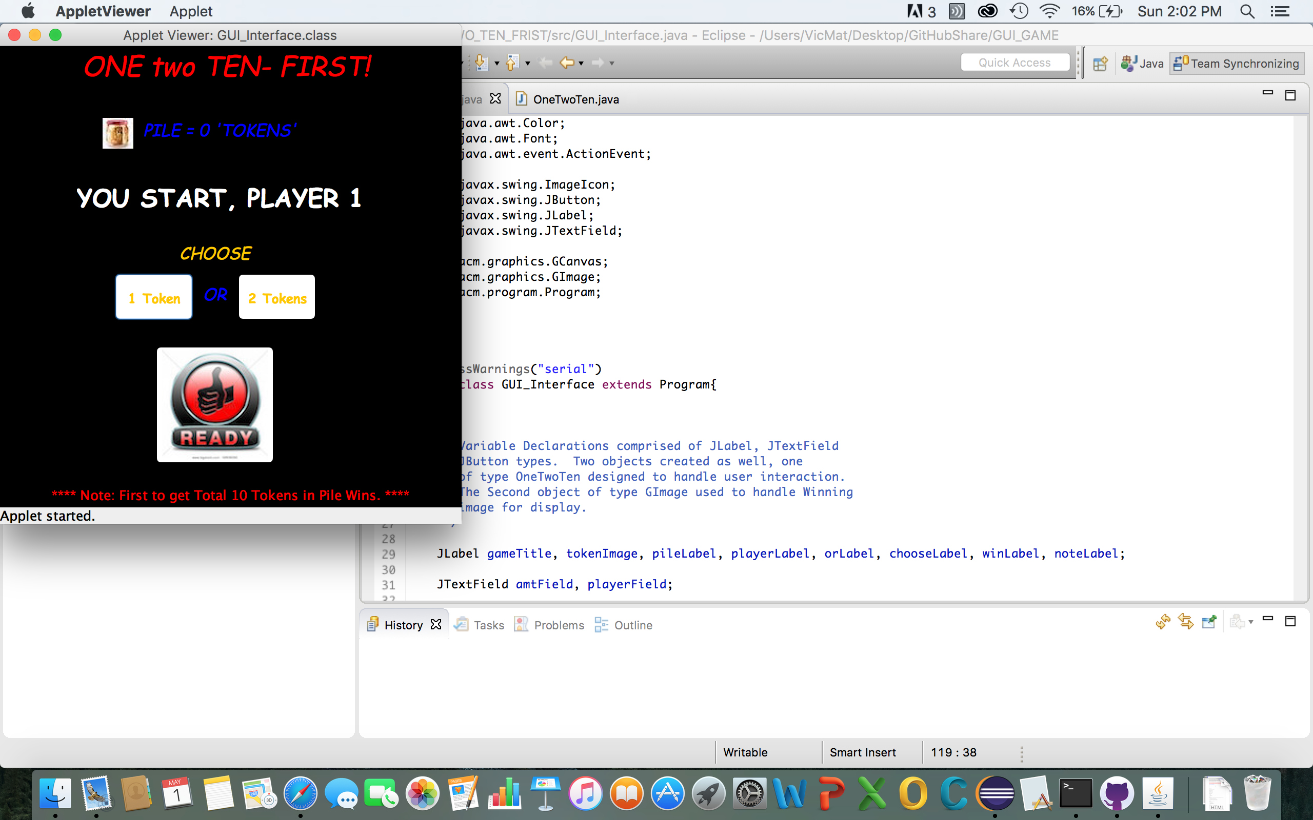
One Two Ten First
The beginning applet has pile set to 0 tokens and initiates player 1 to choose 1 or 2 tokens. As you can see the go button is set to ready until token choice is selected.

Slide 2

The ready button was selected without choosing token and applet token fields or player field did not get updated.

Slide 3
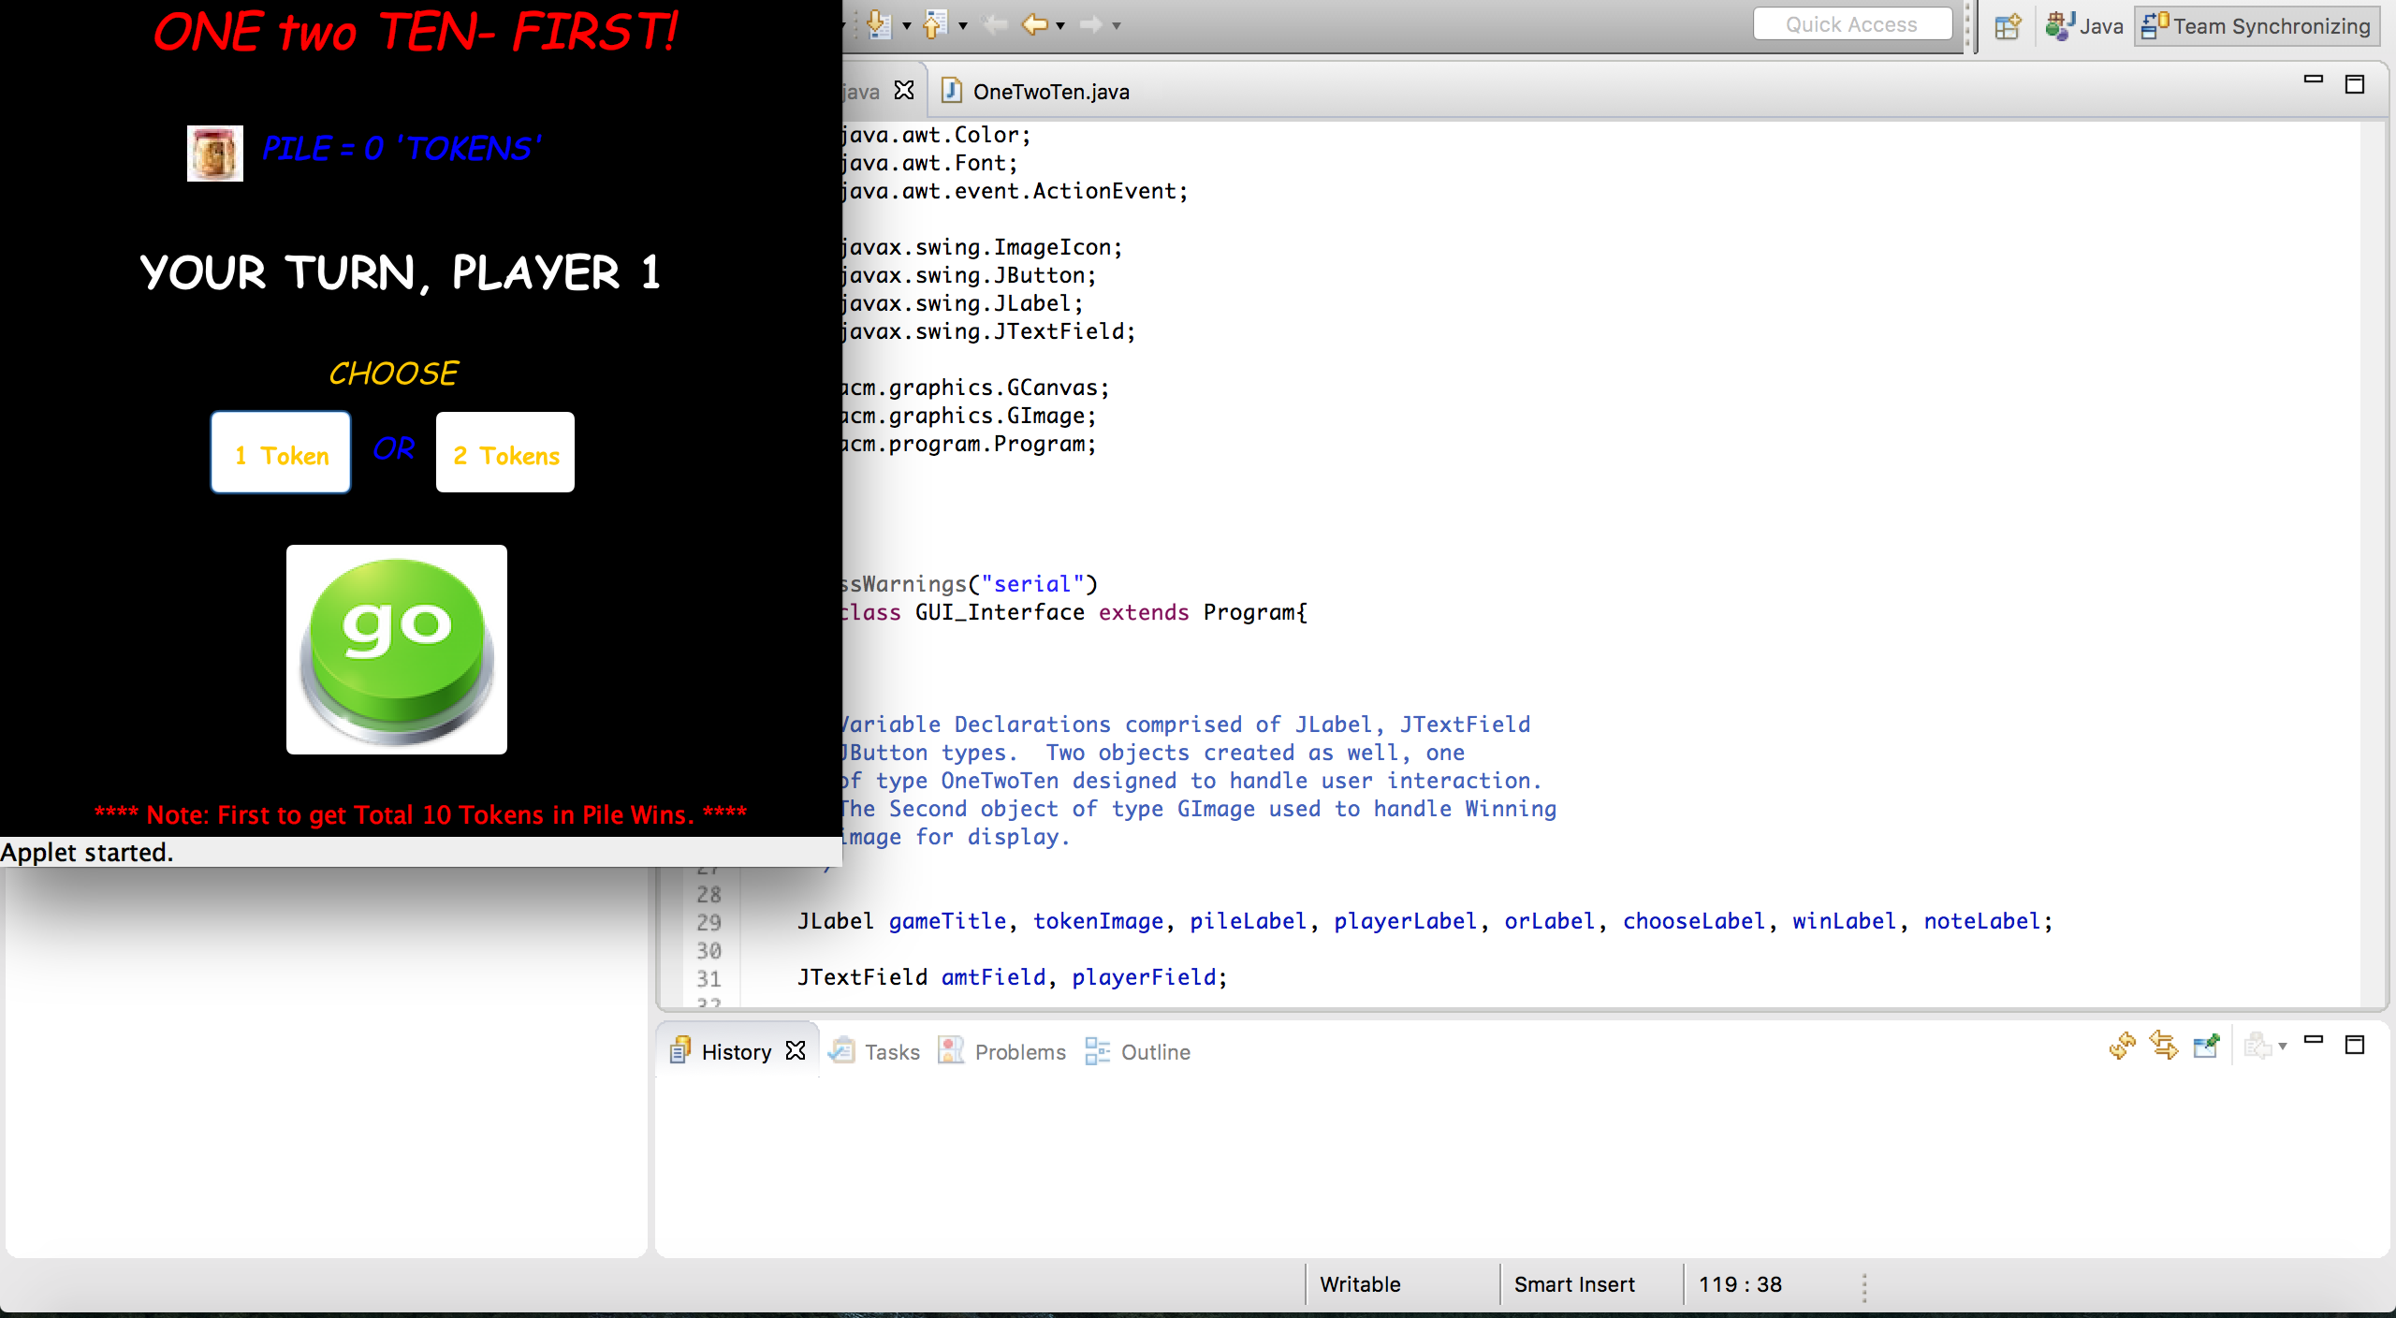
Player one has selected 1 token but token field has still not been updated but the ready button has now turned to go. Error check: if the player chooses 1 token then decides to play 2 token the last token selection is updated.

Slide 4
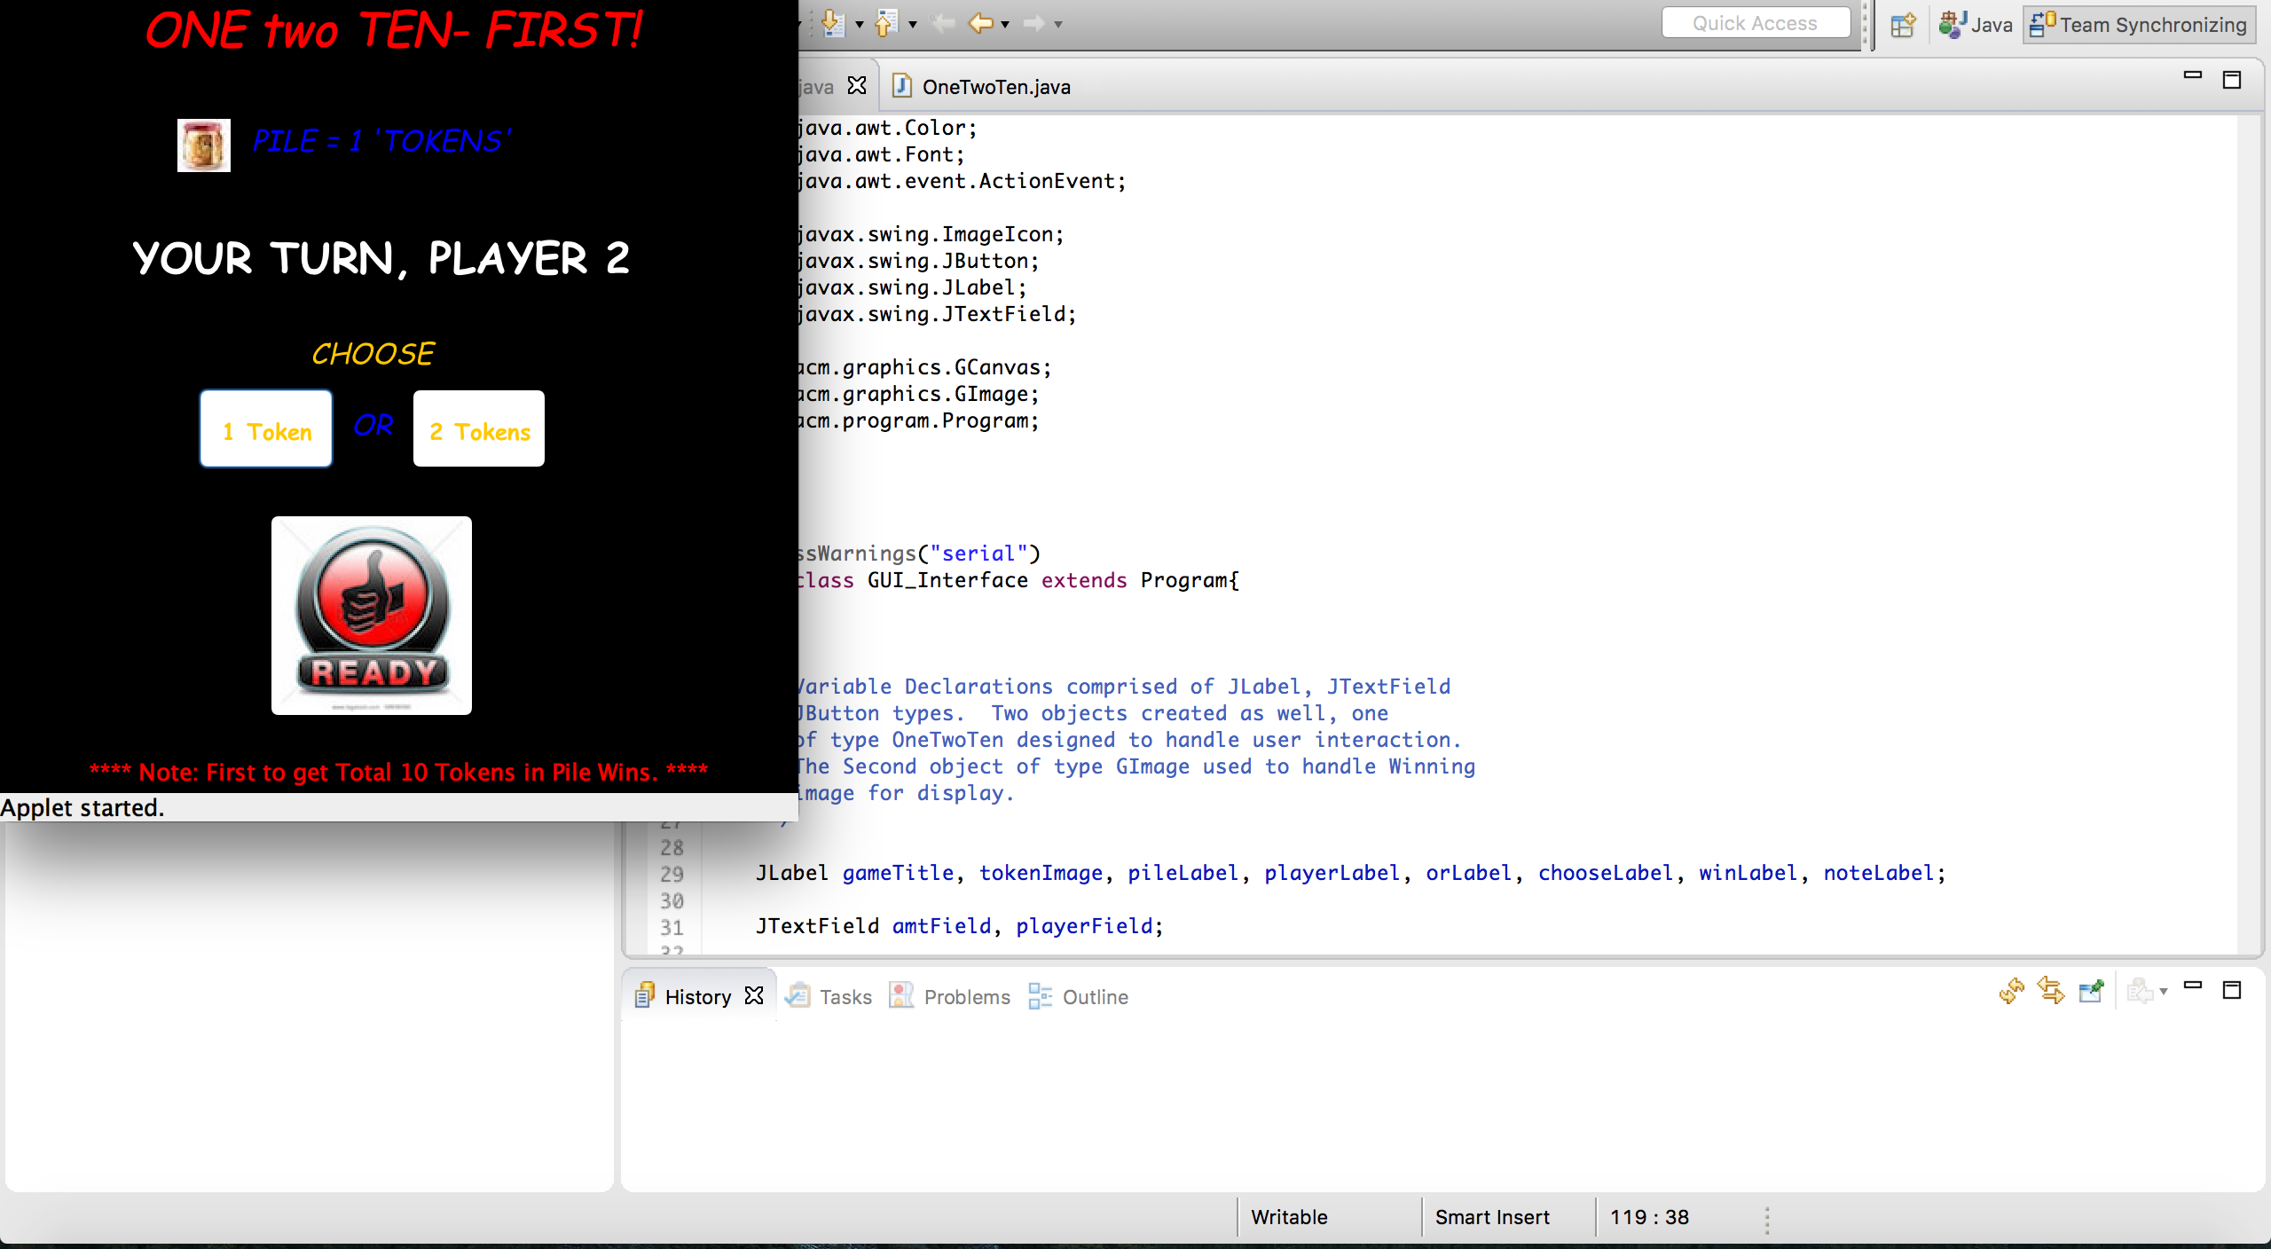
As you can see now after the go button has been selected that the pile field has been updated to 1 token and the player field now updated to player 2 along with the go button reverting back to ready.

Slide 5

Player 2 has now selected 2 tokens to add to the pile. Player field is still set to player 2 but ready button has now been updated to go. Pile field has not been updated either since go button has not been selected yet.

Slide 6

After player 2 selected go button now you can see the pile field updated to total of 1+2=3 tokens. The player field is now updated to player 1 and the go button updated to ready button.

Slide 7

The game has continued an now player 2 has the choice to choose 1 or 2 tokens with a total of 9 tokens in pile now. For the sake of error testing player 2 selects 2 tokens which when the go button is selected no fields but the player field is updated- seen on next silde.

Slide 8
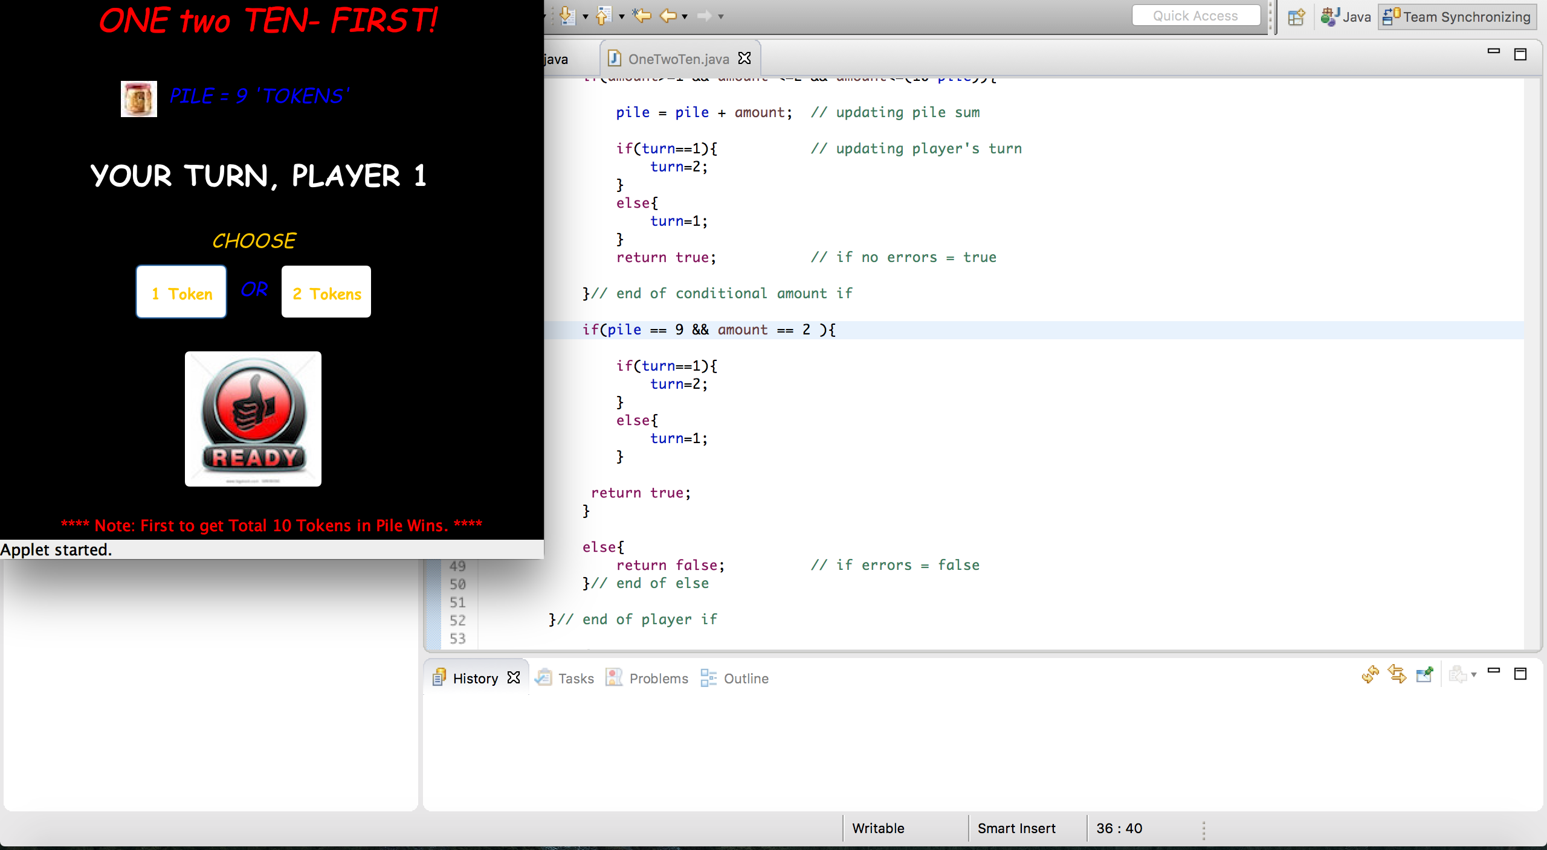
As you can see the with continuing error checking player 2 selected 2 tokens but the pile field stayed the same but player field updated to player 1 along with go button resetting to ready.

Slide 9
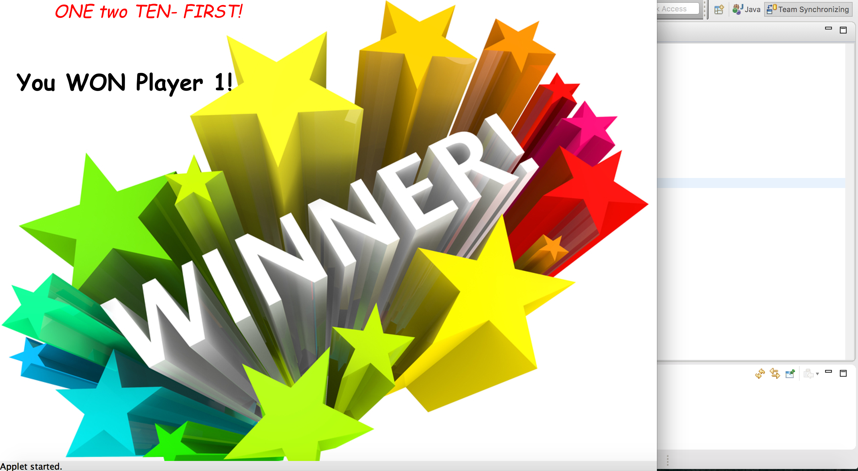
Now that player one selected 1 token to make total of 10 tokens Player 1 wins and therefore the winning banner is displayed while hiding all other buttons and fields.

